Slide 1
AI-Driven Guest Profiling for Hotel Management
Author - Mithun Dama
Affiliation - Pace University
Email - md19602n@pace.edu
mithundama1997

Slide 2

Research Questions & Problem Statement
Research Questions:
AI's role in enhancing guest experience?
AI's ability to predict/mitigate hotel issues?
Benefits of real-time guest profiling?
Problem Statement:
Gaps in understanding guest behaviors.
Operational inefficiencies.
Need for a dynamic predictive system.

Slide 3
Literature Review
Key Insights
Positioning & Needs for Our Work
1. AI Integration in Hotel Management
Simplifies operations & bridges communication (Deshpande)
Enhances user experience
2. Machine Learning in the Hotel Sector
Used for demand forecasting & online reviews analysis (Eid Alotaibi)
China leading in AI adoption
3. Natural Language Processing (NLP)
Analyzes online reviews for customer insights (Takayuki Suzuki)
NLP categorizes language patterns based on hotel values
4. Facial Recognition in Hotels
Streamlines check-ins & boosts security (Zhang-Bin Chen and Yang Liu)
5. Predicting Booking Cancellations
ML models trained on past data to forecast cancellations (M. Venkata Rakesh)
Emphasizing guest profiling using AI
Integrating NLP, ML, and facial recognition for a holistic solution
Implementing a guest behavior scoring system

Slide 4
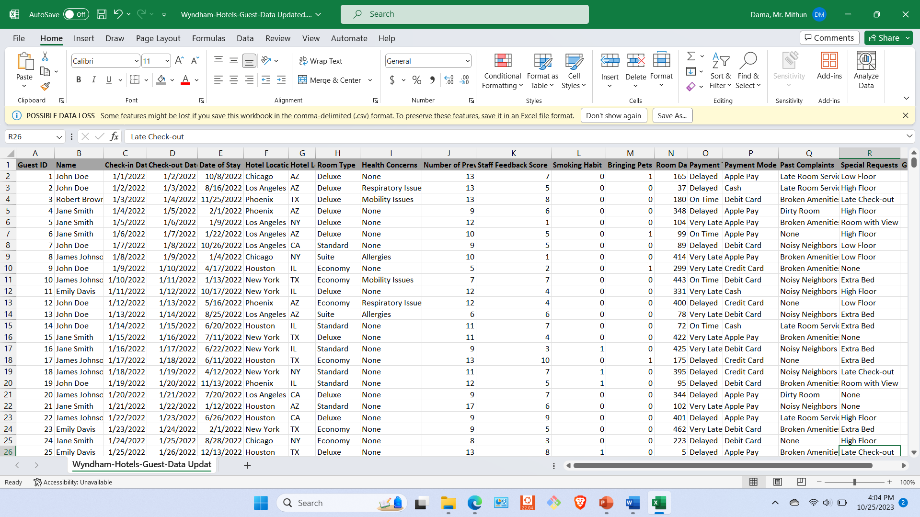
Dataset
Link to the data: Wyndham-Hotels-Guest-Data Updated.xlsx
Description:
Date: Data generated in September 2023
Country: United States (New Jersey)
Details: This dataset provides a comprehensive view of guests' behaviors, preferences, and interactions with the hotel. It encompasses key metrics and events spanning over a typical stay in a hotel.
Size: 10,000 entries
Parameters:
Guest ID, Name, Check-in & Check-out Date
Hotel Location (City & State), Room Type
Health Concerns, Previous Stays, Staff Feedback
Smoking Habit, Pets, Room Damages ($)
Payment Timeliness & Mode, Past Complaints
Special Requests, Guest Behavior Score
Note: This dataset is a dummy dataset generated for project purposes.

Slide 5
EDA for Other Attributes
Preliminary EDA Results:
Guest Behavior Score Distribution: Significant variations observed across different hotel locations and room types. Clear patterns emerged correlating guest behavior with factors like smoking habits and pet accommodations.
Frequency of Health Concerns: Majority of guests do not mention health concerns, but there's a notable segment that requires special accommodations.
Room Damage Analysis: A direct correlation observed between room damages and certain behavior patterns.
Payment Timeliness: A significant portion of guests have a consistent record of timely payments, but there's a small segment with repeated late payments.
Methodology & Experimentation:
Data Cleaning: Removal of outliers, handling of missing values, and normalization.
Feature Engineering: Extracting key features from the dataset to enhance the predictive capabilities of our model.
Model Selection: Based on preliminary analysis, decision trees or ensemble methods like Random Forest might be suitable due to the categorical nature of many attributes.
Model Training: Utilize a split of 70-30 for training and testing. Cross-validation will be employed to ensure model robustness.
Performance Metrics: Focus on accuracy, precision, recall, and F1-score for model evaluation. Given the business context, emphasis will be on minimizing false negatives

Slide 6
Visually Plotted Preliminary EDA Results:

Slide 7
Next Steps
Data Validation: Ensure the integrity and consistency of the dummy dataset.
Model Refinement: Based on preliminary results, optimize the AI model for better accuracy.
Integration: Work on integrating the AI model with hotel management systems.
Feedback Loop: Establish a mechanism to receive feedback from hotels using the system to continuously improve the model.
Expand Data Sources: Collaborate with more hotel chains to gather diverse datasets, ensuring robustness of the model.
User Interface: Develop a user-friendly interface for both hotel staff and guests, ensuring ease of use and understanding.
Training Sessions: Organize training sessions for hotel staff to effectively use the AI model.
Continuous Monitoring: Regularly monitor the system for any anomalies and ensure it's updated with the latest AI algorithms and techniques.

Slide 8
References
Deshpande. 2022. An AI Integrated Online Hotel Management System. Journal of Web Engineering & Technology, Volume 9, Issue 1. http://computers.stmjournals.com/index.php?journal=JoWET&page=index
Eid Alotaibiy. 2020. Machine Learning in the Hotel Industry. (JAAUTH), Vol. 18 No. 3, (2020). https://jaauth.journals.ekb.eg/
Pongsakorn Limna. 2022. Artificial Intelligence (AI) in the Hospitality Industry: A Review Article. International Journal of Computing Sciences Research. (JAAUTH), Vol. 18 No. 3, (2020) . orcid.org/0000-0002-7448-5261
Takayuki Suzuki, Kiminori Gemba, Atsushi Aoyama. 2023. Hotel Classification Visualization Using Natural Language Processing of User Reviews. Graduate School of Technology Management, Ritsumeikan University, Shiga, Japan.
Zhang-Bin Chen, Yang Liu. 2021. Application of Face Recognition in Smart Hotels. IEEE.
M. Venkata Rakesh. 2022 . Hotel Booking Cancellation Prediction using ML algorithms. Department of CSE, Sathyabama Institute of Science and Technology, Chennai. [DOI: 10.1109/ICAIS53314.2022.9742843]

Slide 9
Thank You

